Slide 1

DriverPass System Analysis
Sarah Dowd
Notes:
[No speaker notes required for this slide.]

Slide 2

System Requirements
Web-based platform accessible anywhere
Secure user accounts with different access levels
Online booking system for driving lessons
Three training package options
Practice tests and progress tracking
Integration with DMV updates
Notes:
We've designed the system to be accessible from any device with internet access. This means your staff and customers can use the system from anywhere. The system includes all the features you requested, from lesson booking to practice tests, with different access levels for staff and customers.

Slide 3
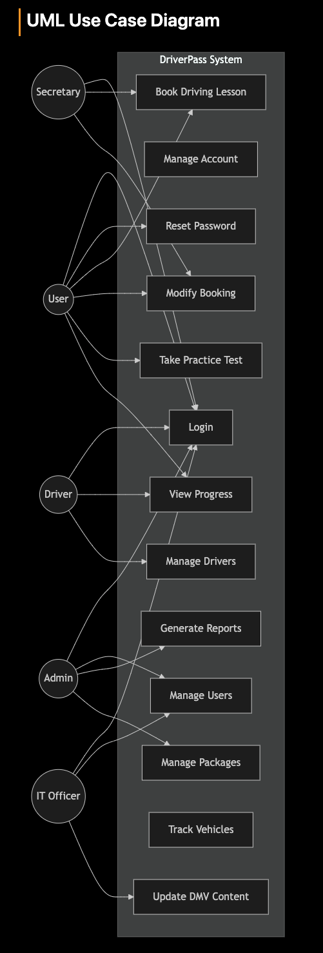
Use Case Diagram
Notes:
This diagram shows what different users can do in the system. For example, customers can book lessons, take practice tests, and view their progress. Your staff members have additional capabilities - secretaries can manage bookings, IT officers can manage user accounts, and administrators have full system access.

Slide 4
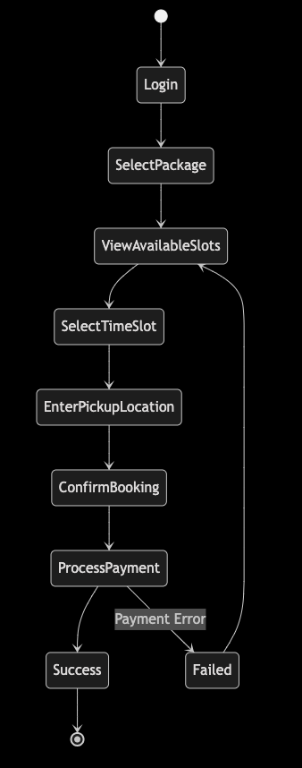
Activity Diagram
Notes:
Here's how the booking process works from start to finish. When a customer wants to book a lesson, they'll log in, select an available time slot, enter their pickup location, and complete the payment. The system automatically checks for instructor and vehicle availability to prevent double-booking.

Slide 5
Security
Secure login system
Password protection
Data encryption
Activity tracking
Automatic backups
Payment security
Notes:
Security is a top priority. All user data and payment information will be encrypted. The system tracks who makes changes to bookings and when, providing the audit trail you requested. We're also implementing automatic backups to protect your business data.

Slide 6
System Limitations
Requires internet connection
Package modifications need technical support
Limited to 10 vehicles initially
Offline data viewing only
DMV update frequency depends on their system
Notes:
While the system is robust, there are some limitations to be aware of. The system requires internet access to make changes, though you can download reports to view offline. Adding new package types will require technical support, but you'll be able to enable or disable existing packages as needed.

